Slide 1


Breast Health Marketing and Communications Plan
“Excellence in Breast Care – For You”
Updated 5-15-19
Corporate Communications

Slide 2
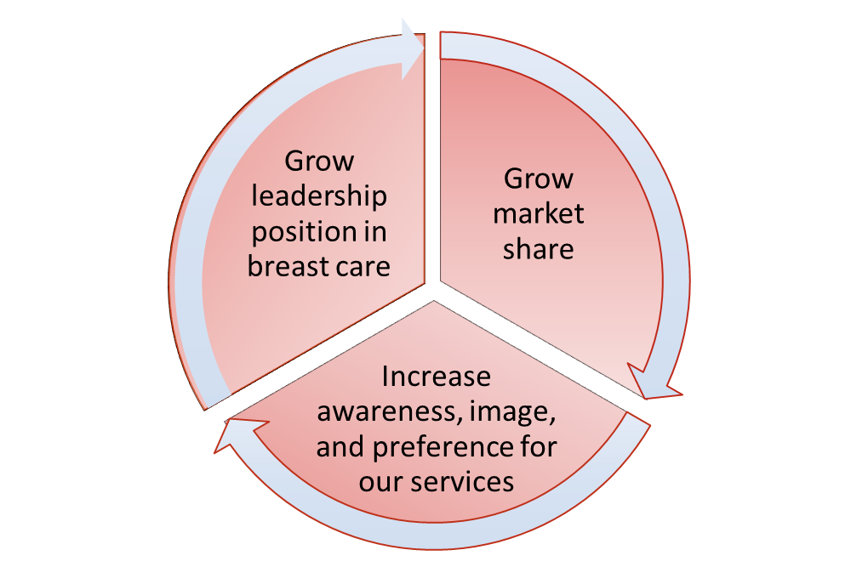

MARKETING OBJECTIVES

Slide 3
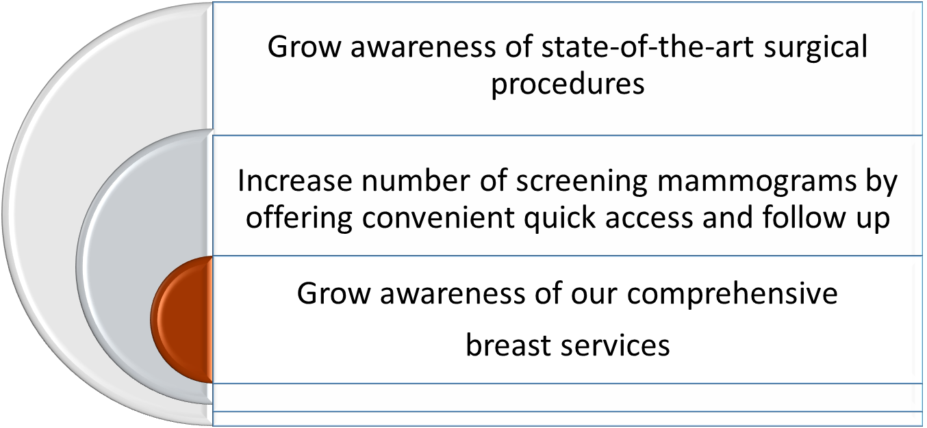
TOP BUSINESS OBJECTIVES

Slide 4
GROWTH STRATEGY
Goals of Breast Care Strategy:
Attract new, prospective patients to St. Peter’s Health Partners
Build/enhance partnerships with new and existing referring physicians
Raise awareness of accreditations, quality of care and clinically-advanced technology
Position SPHP as a leader in minimally invasive, advanced breast conservation techniques
Educate consumers and providers on the strong collaboration of surgery, oncology, imaging, genetics, pathology, and physical therapy

Slide 5
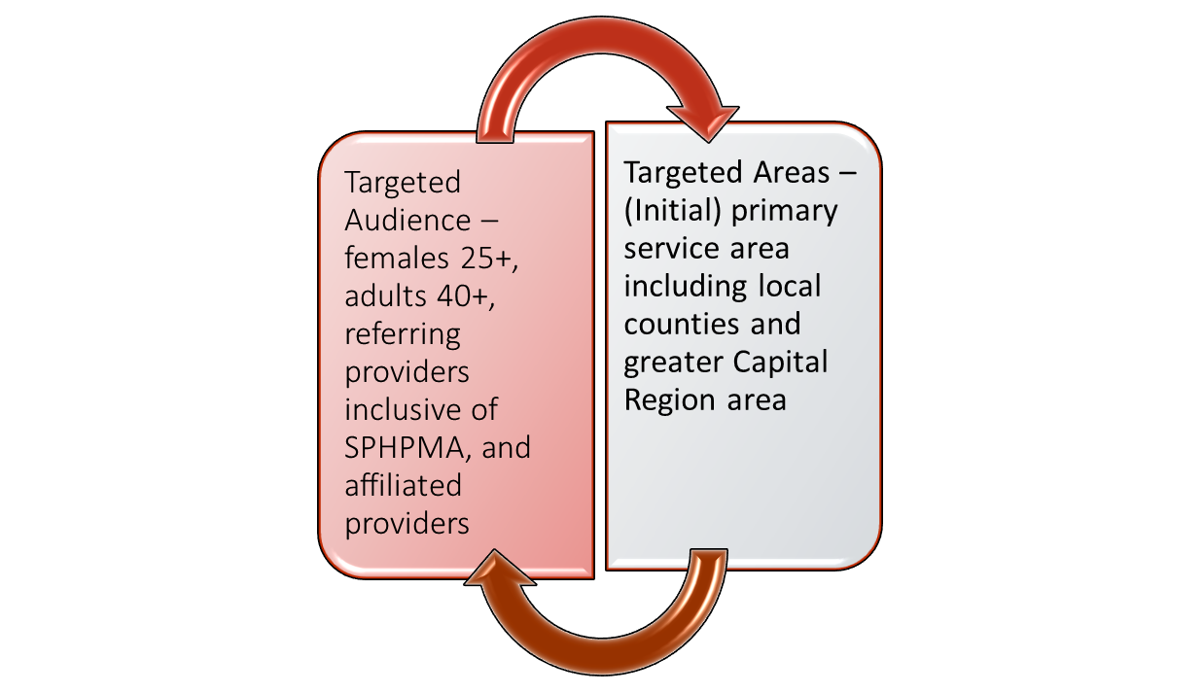
TARGET AUDIENCE

Slide 6
KEY MESSAGES

Slide 7

KEY MESSAGES
“Excellence in Breast Care – For You”
Collaborative team approach
Tissue sparing surgery/ faster healing,
less invasive
National accreditations
Fellowship-trained surgeons

Slide 8
MARKETING AND
COMMUNICATIONS PLAN

Slide 9





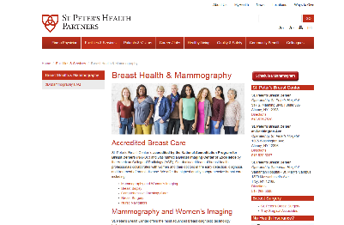








Marketing Plan
MEDIA CAMPAIGN OVERVIEW
Paid Media
AD
Print
OOH
Paid Search
Social
Digital Display
Owned Channels/Assets
Earned Media
Website
SPHPMA & SPHP Newsletters; SPHP News Page ,
Case Study
Public Relations
Call Center
Collateral
Video

Slide 10
TARGET AUDIENCES
Demographic Target – Women 25+, Adults 40+;
Geographic Target - Albany, Schenectady, Troy DMA (DMA includes the following counties: Albany, Schenectady, Rensselaer, Saratoga, Columbia, Greene, Fulton, Montgomery, Schoharie, Hamilton, Warren, Washington, Bennington, and Berkshire)
Referring providers including SPHPMA and affiliated providers

Slide 11
MARKETING TACTICS- CONSUMER
Develop provider videos for Drs. Kaufman and Pesek, including additional videos focusing on breast conservation and team collaboration
Enhance website content (within new TH parameters)
Develop copy and videos from other Cancer Care team members i.e. You’ve been diagnosed with breast cancer: what to expect
Promote video on website, social media (FB, Instagram, YouTube), SEM
Develop print ads – full page focusing on accreditation
¼ page educational focusing breast conserving surgery
Develop/enhance patient education materials i.e. breast conservation techniques

Slide 12
MARKETING TACTICS- CONSUMER
Develop digital campaign to drive consumers to website
Continue to partner with affinity groups, To Life!, ACS (community seminars), Komen
Billboard on I-90 and Route 7
Media relations/earned media/ news
Livesmart article
SPHP News/SPHP Facebook page

Slide 13
MARKETING TACTICS – PHYSICIANS
Continue targeted outreach
Develop provider one-sheet as a leave behind for providers with contact information and call to action
Create a case study to be mailed to SPHPMA and affiliated providers
SPHPMA News
Participate in community events including To Life!, ACS
Present at Grand Rounds

Slide 14
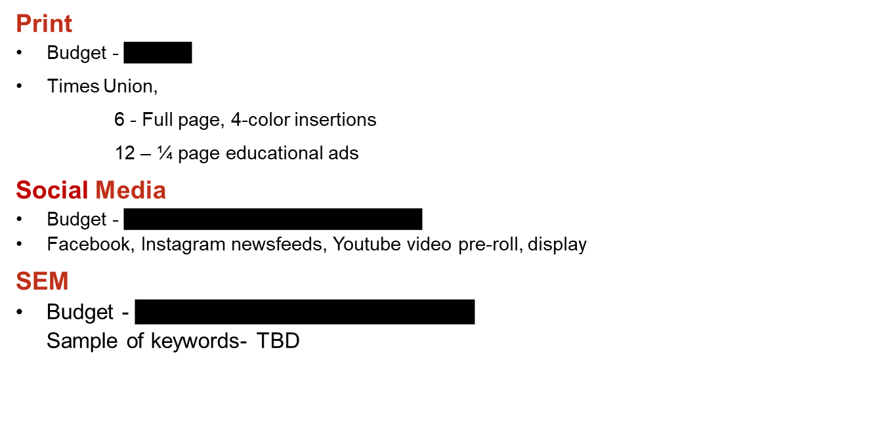
Marketing Plan
PAID MEDIA – 4 MONTHS

Slide 15

Marketing Plan
PAID MEDIA– cont’d

Slide 16
Marketing Plan
OWNED MEDIA
Web Site
Update as needed
Add provider videos and patient testimonials
Newsletters
SPHPMA and SPHP newsletters
Collateral/Signage
Case study and brochure

Slide 17
Marketing Plan
EARNED MEDIA
Social Media
SPHP Facebook, Twitter, Youtube, flickr, Instagram
Facebook Live
Public Relations
SPHP news page
Select stories TBD
LiveSmart health page article
WAMC Kaufman interview – 5/13

Slide 18
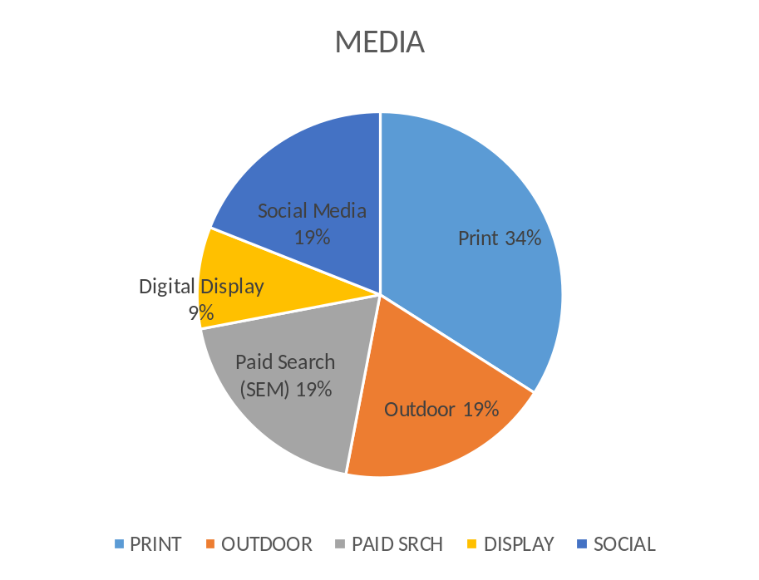
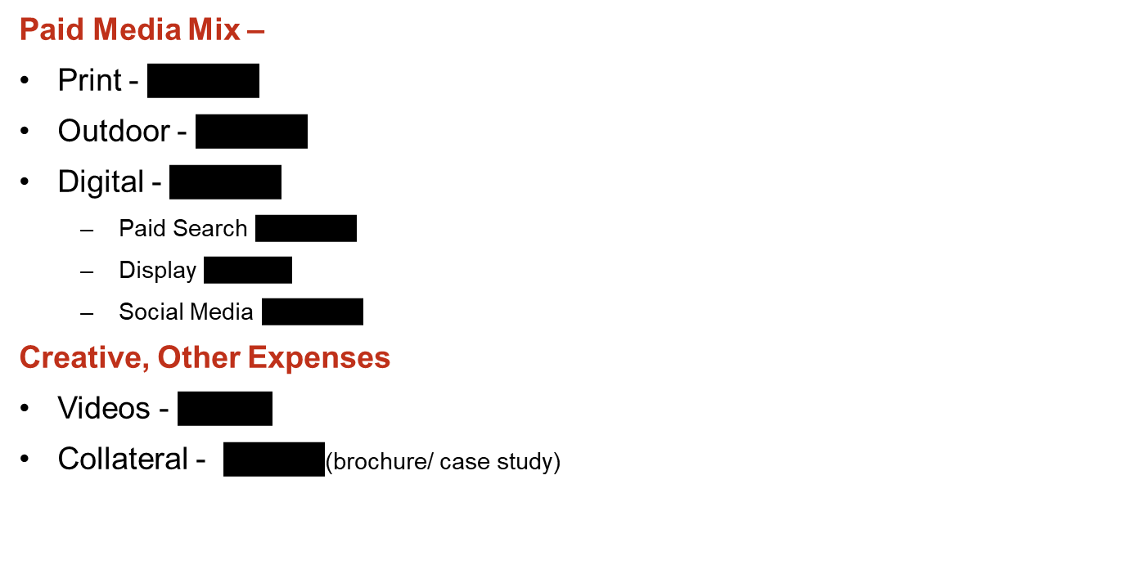
Marketing Plan
PAID MEDIA OVERVIEW – 4 MONTHS

Slide 19
Marketing Plan
TENTATIVE TIMELINE
 | Jan | Feb | Mar | Apr | May | June | July | Aug | Sept | Oct | Nov | Dec
Print
Outdoor
Paid Search
Digital Display
Social Media
Creative (includes video & web)
Public Relations

Slide 20
TRACKING

Slide 21
Marketing Plan
PLANNED METRICS
Optimize marketing performance through tracking, measuring, and refining
Response
Digital analytics (CTR, impressions, conversion rate, website engagement, video views, etc..)
Track organic and digital media visits
Patient volume (Mammography and breast surgery)
ROI
Average cost per engagement
Average cost per lead

Slide 22
Marketing Plan
REPORTING AND FULFILLMENT
Reporting
Web Site stats (traffic, downloads, engagement)
  Shared monthly, EOC.
Patient Volume
  -- Shared monthly, EOC.
Digital Media
  Shared monthly, EOC.

